Slide 1

Happy Tummy

Slide 2
Table of Contents
Introduction
User Types & Functions
Front End Model
Tech Stack
Backend Model
Future Implementations

Slide 3
Introduction
What is Happy Tummy?
Happy Tummy is a web application that facilitates the user to shop for the best quality ingredients for their own recipes or for any online recipes worldwide under a single web space. It offers an interactive service to the users wherein the users will have an option to choose a wide variety of recipes from across the globe.
Unique Features of Happy Tummy:-
Create Recipes: Users can create/build their own recipes with the ingredients listed on the application.
Pre-existing Recipes: Back-end vendors will provide the recipes and the selected ingredients to the user.
Feed - A page where users can post the recipes that they have created. This also lets other users to view, like and share the recipe.

Slide 4
User Types & Characteristics
Registered Users
Users who have an account created with registered address.
Registered users will be allowed to view, create/select recipes and place orders.
Unregistered Users
Users who do not have an account & known as guest users.
These users will only be able to view recipes and cannot place orders.
Admins
Admin is authorized to monitor the orders & modify the ingredients/recipes list

Slide 5
User & System Function
Customer Procedure (User Function):-
Login/signup - Application requires customers to create an account before placing an order. If already signed up, customers can directly sign in
After the customer has signed in, application allows the customer to do the following:
Search for a recipe - Customers can search for a recipe in a search box using keywords which displays the recipes list as search results
Select recipe & place an order - The customer can look up for any recipe available on the web/search results and place an order after selecting the required ingredients and servings.
Create recipe & place an order - Customers can create recipes by providing details such as recipe name, time required, description and ingredients.
Feed - Customers created recipes can be posted onto the feed. And also recipes can be liked & shared with each others.
My order - Customers can view past & current orders on this page.
Customer guide - FAQs are provided on the web app to enable the user to understand the working of the application better. There is an email support available for anyone who has questions other than the FAQs.

Slide 6
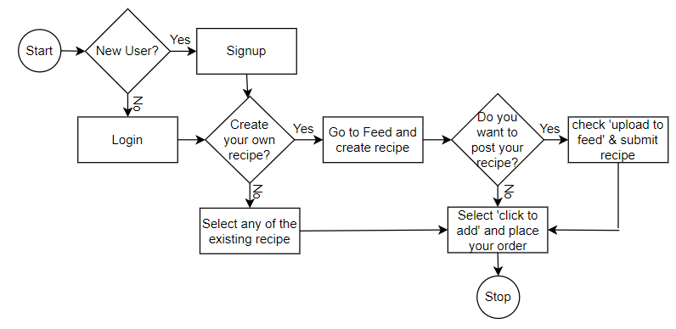
Frontend Model

Slide 7
Admin & System Function
Admin Functions:-
Admin can view list of all the ingredients, recipes and users/customers
Ability to approve or decline the addition of a new recipe.
Can modify the ingredients list based on availability or lack of a recipe.
Backend System Functions:-
The backend server will feature a web crawler that will scrape certain specified reputable web/mobile apps for viable recipes and identify and isolate the ingredients and their corresponding quantities.

Slide 8
Tech Stack
Hardware Specifications
Server with an Intel Processor
Sufficient RAM (>=2GB)
Software Specifications
React Framework for the web app
SQL as a database communication language
Python for API and crawler development
Django for the Backend

Slide 9
Backend Model
Server will periodically
crawl certain verified
websites for recipes
Recipes will be selected
Database will validate username and password.
Identify the
ingredients with their
respective quantities
for 1 serving

Slide 10

Future Implementations
Payment Methods.
Delivery Partners.
Order Management based on Priority.
Filter posts in Feed based on Location or Cuisine.
Ability to Follow user profile.
Ability to Track Order Status.
Identify a recipe based on ingredients in hand
The user can also order ingredients separately depending on what he/she desires.

Slide 11
Thank you

